Slide 1


LOW
HIGH

Slide 2
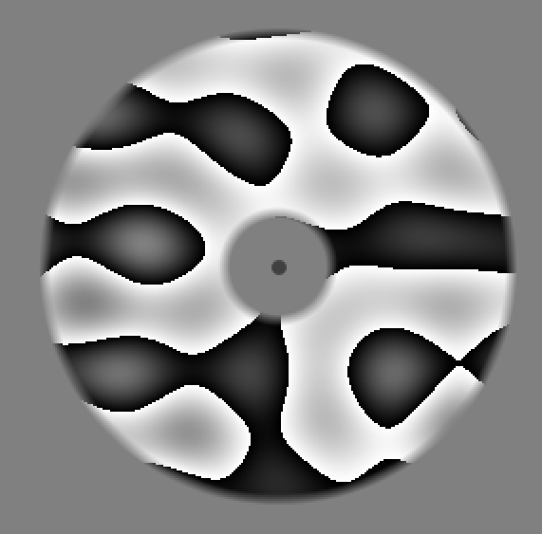
Match or not?
Y N
Notes:
We will use a match-to-sample paradigm where subjects will be required to match either the orientation or spatial frequency of a visual grating: their task is to indicate whether target and probe were the same or different with respect to the attended feature. The attended feature will be indicated by a visual cue that is either double solid lines to attend to orientation or double dashed lines to attend to spatial frequency. Feature cueing will occur either before target presentation in the pre condition or after it in the retro condition. Gratings will have have four possible orientations and spatial frequencies . And color will be an irrelevant feature.

Slide 3


Match first one
Match second one
Not informative
Notes:
We will use a match-to-sample paradigm where subjects will be required to match either the orientation or spatial frequency of a visual grating: their task is to indicate whether target and probe were the same or different with respect to the attended feature. The attended feature will be indicated by a visual cue that is either double solid lines to attend to orientation or double dashed lines to attend to spatial frequency. Feature cueing will occur either before target presentation in the pre condition or after it in the retro condition. Gratings will have have four possible orientations and spatial frequencies . And color will be an irrelevant feature.

Slide 4
Match or not?
Y N
Match or not?
Y N
Notes:
We will use a match-to-sample paradigm where subjects will be required to match either the orientation or spatial frequency of a visual grating: their task is to indicate whether target and probe were the same or different with respect to the attended feature. The attended feature will be indicated by a visual cue that is either double solid lines to attend to orientation or double dashed lines to attend to spatial frequency. Feature cueing will occur either before target presentation in the pre condition or after it in the retro condition. Gratings will have have four possible orientations and spatial frequencies . And color will be an irrelevant feature.

